Slide 1
ARM® AMBA® AXI
Advanced eXtensible Interface

Slide 2
Topics
Overview of AXI
AXI architecture and features
Channel definitions and signals
Handshaking process
Basic AXI transactions
Types of Access (Atomic Accesses)
Ordering model (Transaction ID tags)
AXI4 & AXI4 Lite

Slide 3
Overview of AXI

Slide 4









System-On-Chip (SoC)
AHB
USB
AXI
ARM A-15
Memory
controller
AXI
AXI
Interconnect
interface
PCIe Express
AXI

Slide 5
AXI Overview
Protocol basics
On-chip communication protocols
Connects multiple masters and slaves with AXI interconnect.
Supports Features:
Burst write & Read transactions
Out of order transactions,
Parallel Write & Read transactions
Over lapped transactions;
Align & Unaligned transfers;
protected and locked transfers
Phased transactions
Write transaction
WR addr phase
WR data phase
WR response phase
Read transaction
RD addr phase
RD data & response phase
Signals classified in channels
AW, W, B, AR, R
Handshaking
Each channel has valid & ready
signal.
AWVALID = 1 @ posedge clk meaning master driving valid information on WR address channel signals.
AWREADY = 1 (slave driven) meaning slave ready to accept master given addr & ctrl info.
At clock posedge, when both AWVALID and AWREADY ‘1’ indicate completion of transfer.

Slide 6
Topics
Overview of AXI
AXI Architecture and Features
Channel definitions and Signals
Handshaking process
Basic AXI transactions
Types of Access (Atomic Access)
Ordering Model (Transaction ID tags)
AXI4 & AXI4 Lite

Slide 7
Architecture

Slide 8
Terminology
AXI : Advanced eXtensible Interface (Interface divided into 5 channels)
Protocol : Set of rules.
Channel : Physical transmission medium (wires) to carry signals.
Signal : It’s an electric current or electromagnetic field that carries
information from one place (source) to another (destination).
Master : Initiates transactions.
Slave : receives and responds to transactions.
Interface : A point where two blocks meet and interact.
Interconnect : a device that allows to connect multiple masters and multiple slaves.

Slide 9
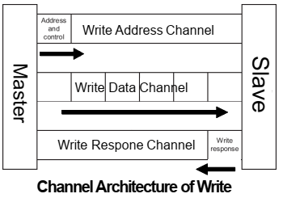
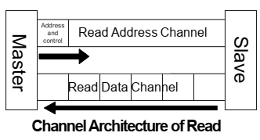
Architecture
AXI is burst-based protocol, where transactions with only start address issued.
Address/Control issued ahead of actual data transfer.
Interface divided into 5 channels.

Slide 10
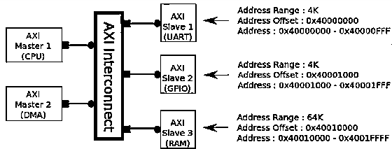
Interface and Interconnect
Each master should be able to initiate transaction to each of slaves with use of interconnect.
Interconnect connects multiple masters to multiple slaves.
Interconnect is slave device for masters & master device for
Slaves
AXI Interface
Source: M.S. Sadri, Zynq Training

Slide 11
Features

Slide 12
Terminology
Transaction : Multiple transfers of data or an entire burst of transfers.
Transfer : A single exchange of information, with one valid and ready
handshake.
Beat : An individual data transfer within an AXI burst.
Burst : A transaction where multiple data items are transferred based
upon a single address.
Aligned : Each data transfer is aligned to the size of the transfer. E.g.: 32-bit transfer aligned to 4-byte boundaries (0, 4, 8, C).
Unaligned : A data access performed to an address which is not aligned to the size of the access. E.g.: A 32-bit data packet that starts at a byte address of 0x1002 is not aligned to the natural 32-bit address boundary.
Multiple outstanding addresses : Master able to provide transaction addresses without waiting for earlier transactions to complete.
Out of order transaction : Transactions to faster memory regions can
complete without waiting for last transaction to slower memory regions
Data Interleaving : Masters producing write data sequence to same slave but data not arriving each clock, interleave to avoid idle cycles on bus.

Slide 13
Features
Burst Write and Read transactions.
Separate address/control and data phases.
Separate Read and Write data channels.
unaligned data transfers using byte strobes.
Ex: Accessing 32-bit data starting at address 0x2
Issues multiple outstanding addresses
ID signals
Out of order transaction and Data Interleaving
ID signals

Slide 14
Topics
Overview of AXI
AXI Architecture and Features
Channel Definitions and Signals
Handshaking Process
Basic AXI Transactions
Types of Access (Atomic Access)
Ordering Model (Transaction ID tags)
AXI4 & AXI4 Lite

Slide 15
Channel Definitions

Slide 16
Channel Definition
Each channel is independent and use two-way flow
control
VALID
Asserted when valid data or control information available on channel.
READY
Asserts when receiver can accept the data.
LAST
Asserts while the final data completes

Slide 17
AXI Signals

Slide 18
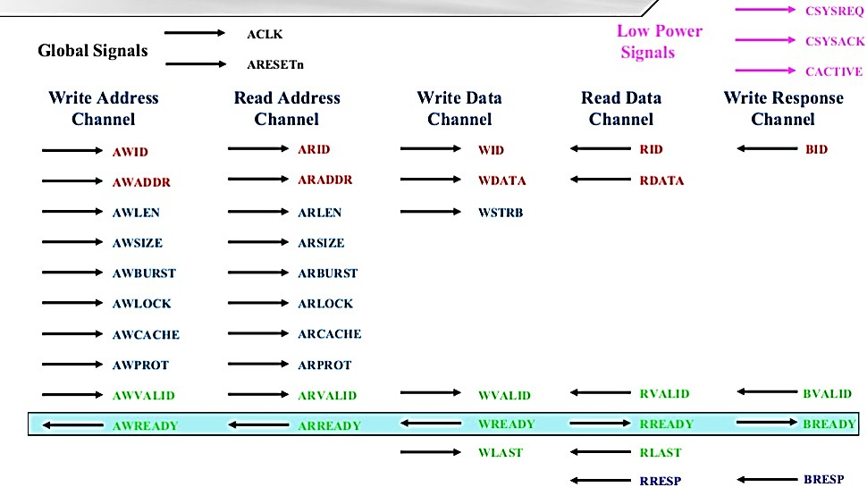
AXI Signals

Slide 19
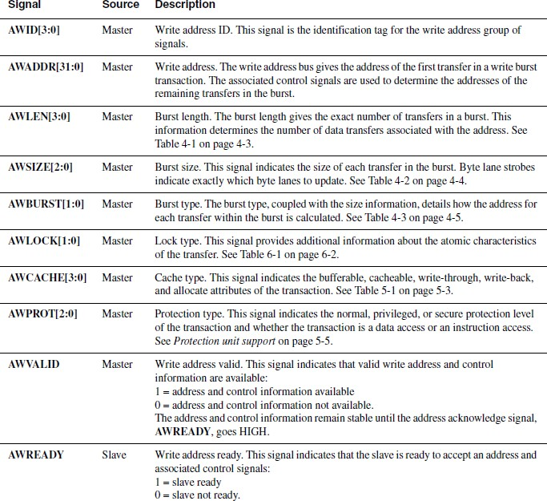
Write Address Channel Signals
Source: ARM AMBA AXI Protocol v1.0: Specification

Slide 20
AXI Signals

Slide 21
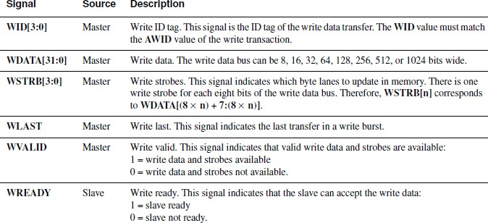
Write Data Channel Signals
Source: ARM AMBA AXI Protocol v1.0: Specification

Slide 22
AXI Signals

Slide 23
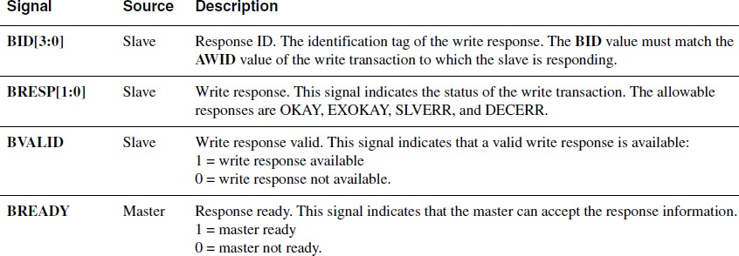
Write Resp Channel Signals
Source: ARM AMBA AXI Protocol v1.0: Specification

Slide 24
AXI Signals

Slide 25
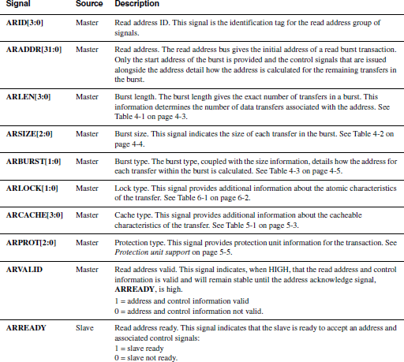
Read Address Channel Signals
Source: ARM AMBA AXI Protocol v1.0: Specification

Slide 26
AXI Signals

Slide 27
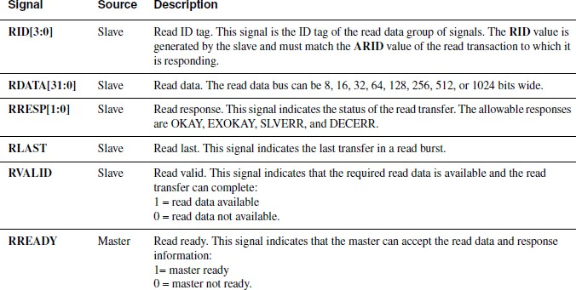
Read Data + Resp Channel Signals
Source: ARM AMBA AXI Protocol v1.0: Specification

Slide 28
Topics
Overview of AXI
AXI Architecture and Features
Channel Definitions and Signals
Handshaking Process
Basic AXI Transactions
Types of Access (Atomic Access)
Ordering Model (Transaction ID tags)
AXI4 & AXI4 Lite

Slide 29
Handshaking Process

Slide 30
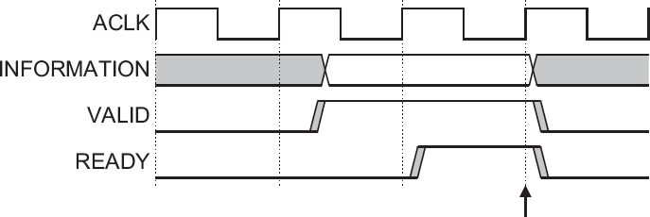
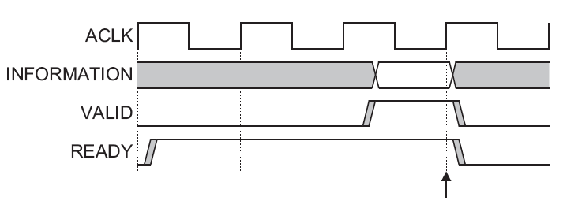
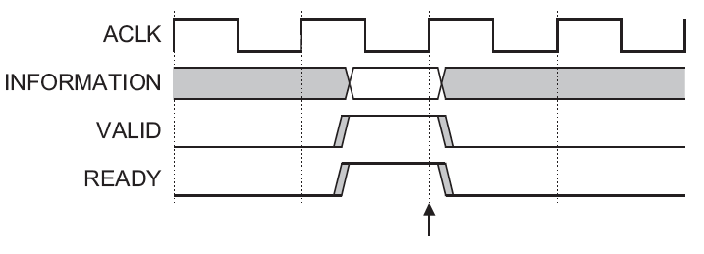
Handshake Process
Information moves
only when
Source is Valid
Destination is Ready
On each channel the master or slave can limit the flow
Very flexible
Source: ARM AMBA AXI Protocol v1.0: Specification

Slide 31
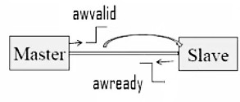
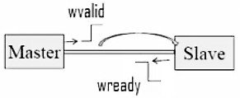
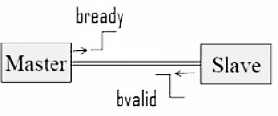
Write channel handshaking
Master provides awvalid to show information valid on write addr channel.
Slave gives awready indicating
address information accepted.
Master provides wvalid to say information is valid in write data channel.
Slave gives wready indicating write data information accepted.
BVALID from slave shows valid information on write response channel
Master gives BREADY indicating write response information accepted.

Slide 32
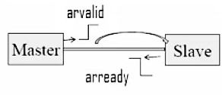
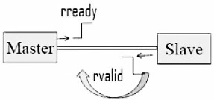
Read channel handshaking
Master provides arvalid to show information valid on read addr channel.
Slave gives arready indicating read
address information accepted.
Slave gives rvalid indicating valid information on read data & response channel.
Master provides rready saying read data & response information accepted.

Slide 33
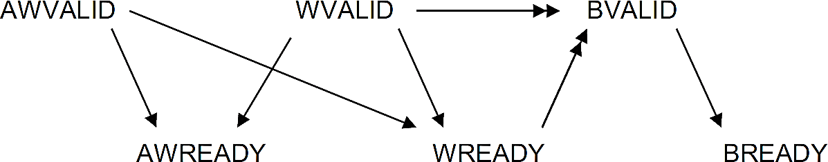
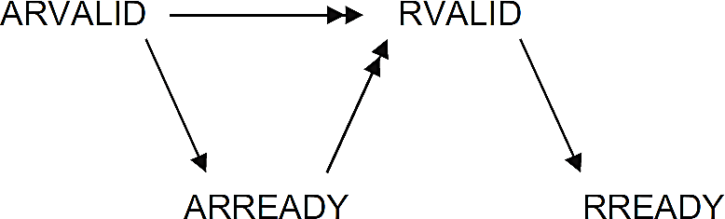
Dependencies between channel handshake signals
Source: ARM AMBA AXI Protocol v1.0: Specification
Write dependency
Slave mustn't give read BRESP unless write addr & data phase completes.
Read dependency
No read data by slave unless read address phase completes.
Slave doesn’t need to wait for ARVALID assertion
Write data can appear before Write address
Write data appear in the same cycle as the address
Read data always come after Read address
Write response always come after write data

Slide 34
Topics
Overview of AXI
AXI Architecture and Features
Channel Definitions and Signals
Handshaking Process
Basic AXI Transactions
Types of Access (Atomic Accesses)
Ordering Model (Transaction ID tags)
AXI4 & AXI4 Lite

Slide 35
AXI Transactions

Slide 36
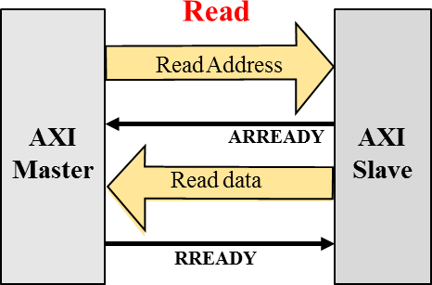
Read Transaction
+ Read Resp

Slide 37
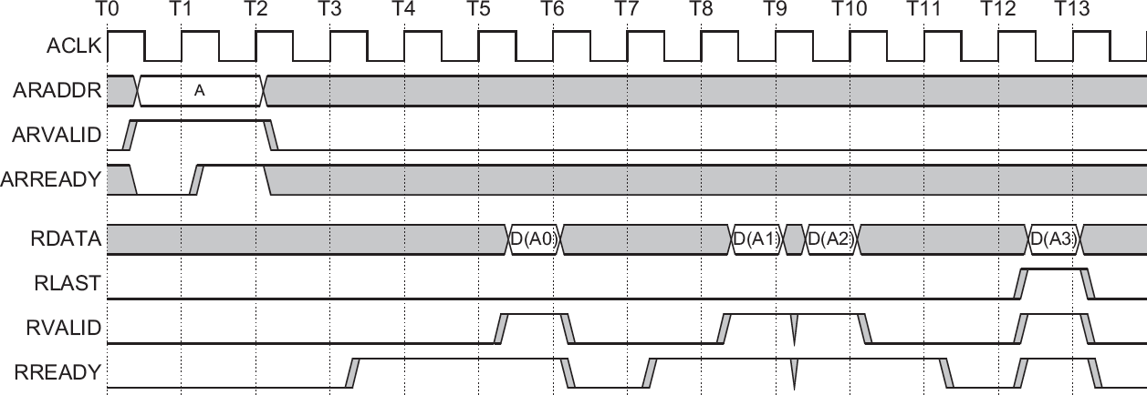
Read Bursts
Read Address Channel
Source: AMBA® AXI Protocol v 1.0 Specification, ARM, 2003.
Read Data Channel
The slave keeps the RVALID signal LOW until the read data is available.
Slave asserts RLAST for final data transfer in a burst indicating last data item
has been transferred.

Slide 38
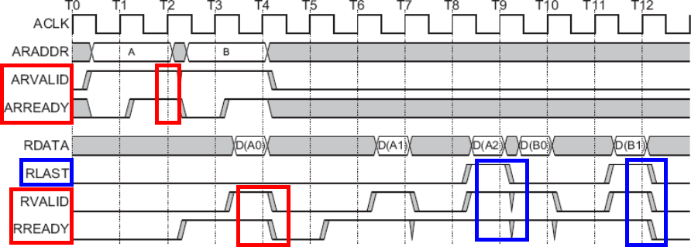
Overlapping Read Bursts
Source: AMBA AXI Protocol v 1.0 Specification, ARM, 2003.
A master can drive another burst address (B) after first addr accepted by slave.
First addr allows slave to process data for the second burst in parallel with the
completion of the first burst (RLAST, D(A2))

Slide 39
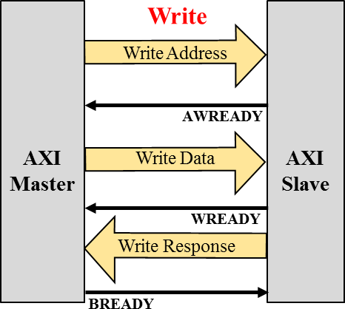
Write Transactions

Slide 40
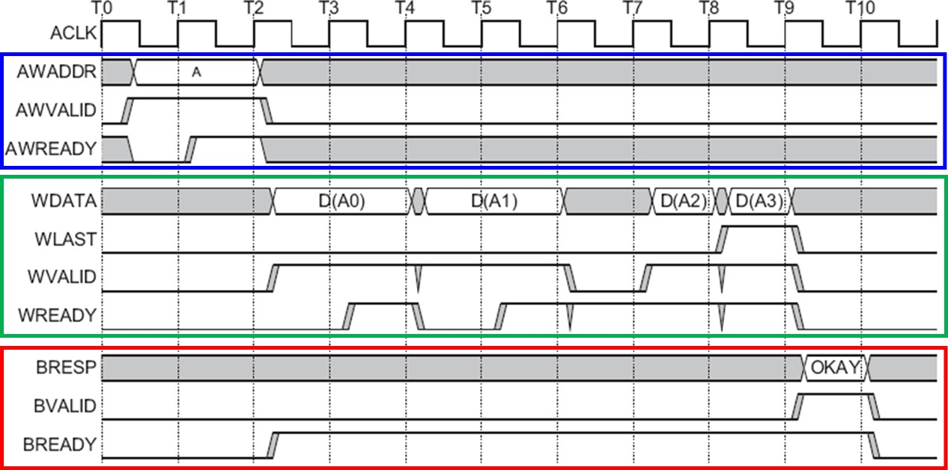
Write Burst
Write Address `Channel
Source: AMBA AXI Protocol v 1.0 Specification, ARM, 2003.
Write Data Channel
Write Response Channel
Source: AMBA® AXI Protocol v 1.0 Specification, ARM, 2003.

Slide 41
Addressing Options

Slide 42
Burst Operation^{[5]}
SIZE
Word halfword
Burst length
Transfer
1 beat
……
2 beats
Burst
4 beats
8 beats
16 beats
Undefined length
………
………

Slide 43
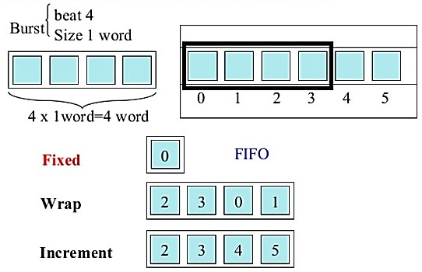
Burst Transfer Type

Slide 44
AXI Burst Transfer
Start address
AXI
ADDRESS
A11 | A21 | A31 |  | A21 |  | A31
DATA
 | D11 | D12 | D13 | D14 | D21 | D22 | D23 | D31
Multiple Data

Slide 45
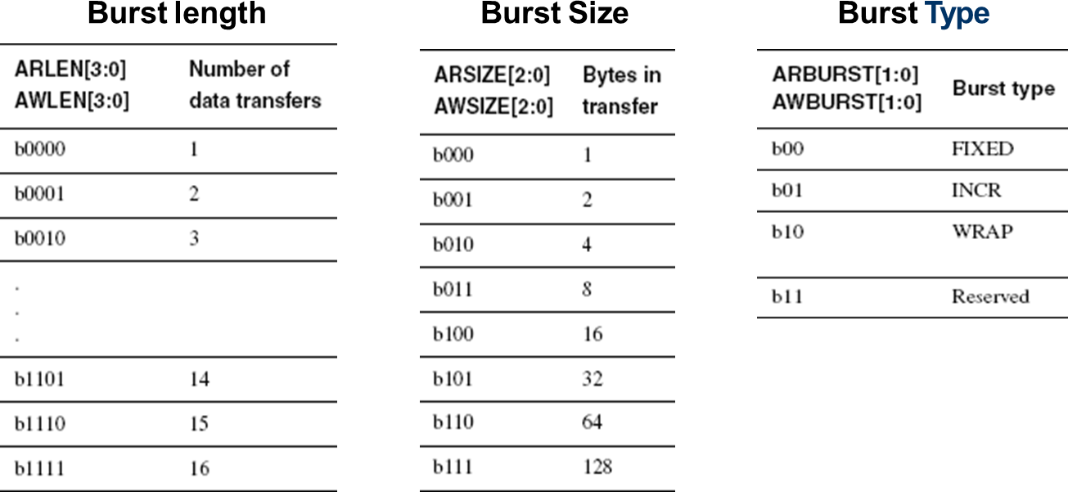
Burst Control signals
Source: AMBA AXI Protocol v 1.0 Specification, ARM, 2003.
Every transaction must have the number of transfers.
No component can terminate a burst early to reduce the no. of data transfers.

Slide 46
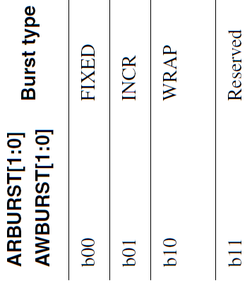
Burst Type
Source: AMBA AXI Protocol v 1.0 Specification, ARM, 2003.

Slide 47
Address calculations

Slide 48
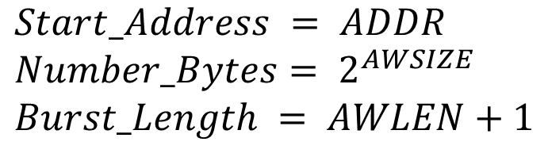
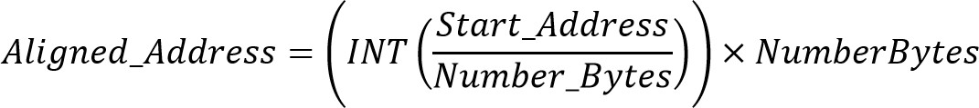
Burst address
Addresses of transfers within a burst:
Address of first transfers in a burst:
𝐴𝑑𝑑𝑟𝑒𝑠𝑠_1 = 𝑆𝑡𝑎𝑟𝑡_𝐴𝑑𝑑𝑟𝑒𝑠𝑠
Address of any transfer after first transfer in a burst:

Slide 49
Burst address
Wrap_Boundary variable extended to get wrapping boundary:
Address of first transfers in a burst:
Address of any transfer after first transfer in a burst:

Slide 50
INCR

Slide 51
Find the address of each transfer in a burst
AWBURST = INCR
AWSIZE = 2
AWLEN = 3
AWADDR = 23C0
Bus_Size = 32 bits Solution Start_Address => 23C0
Number_Bytes => 2 ^{AWSIZE} => 2 ² = 4
Burst_Length => AWLEN + 1 = 3 + 1 = 4
Aligned_Address = INT(23C0/4) x 4 = 8F0 x 4 = 23C0
Address_1 = Start_Address = 23C0
Address_N = Aligned_Address + (N-1) x Number_Bytes
Address_2 = 23C0 + (2 - 1) x 4 = 23C4
Address_3 = 23C0 + (3 - 1) x 4 = 23C8
Address_4 = 23C0 + (4 - 1) x 4 = 23CC
Address : 23C0 , 23C4 , 23C8, 23CC

Slide 52
Fixed

Slide 53
Burst address (Fixed)
AWBURST = FIXED
AWSIZE = 1
AWLEN = 4
AWADDR = 44B0
Bus Size = 32 bits
Start_Address = 44B0 Number_Bytes = 2^{AWSIZE} = 2¹ = 2 Burst_Length = AWLEN + 1 = 4 + 1 =5
Aligned_Address = INT(Start_Address/Number_Bytes) x Number_Bytes
= INT(44B0/2) x 2 = 2258 x 2 = 44B0

Slide 54
Burst Address (Fixed…)
Since, it’s a Fixed Burst , so the Address will be same for each
transfer i.e.
Address_1 = 44B0
Address_2 = 44B0
Address_3 = 44B0
Address_4 = 44B0
Address_5 = 44B0

Slide 55
Wrap

Slide 56
Burst Address (WRAP)
AWBURST = WRAP
AWSIZE = 1
AWLEN = 2
AWADDR = A242
Bus Size = 32-bits
Start_Address = A242 Number_Bytes = 2^{AWSIZE} = 2¹ = 2 Burst_Length = AWLEN + 1 = 2 + 1 =3
Aligned_Address = INT(A242/2) x 2 = 5121 x 2 = A242

Slide 57
Burst Address (WRAP…)
Wrap_Boundary = (INT(A242/( 2 X 3))) X (2 X 3) = A242 Address_N=Wrap_Boundary+(Num_Bytes x Burst_Len)
Address_1 = A242
Address_2 = A242 + (2 - 1) x 2 = A244
Address_3 = A242 + (3 - 1) x 2 = A246
Address_4 = A242 + (4 - 1) x 2 = A248
Address : A242 , A244 , A246

Slide 58
Additional Control Information

Slide 59
Cache Support
Support for system level caches and other
performance enhancing components
Bufferable (B) bit, ARCACHE[0] and AWCACHE[0]
Cacheable (C) bit, ARCACHE[1] and AWCACHE[1]
Read Allocate (RA) bit, ARCACHE[2] and AWCACHE[2]
Write Allocate (WA) bit, ARCACHE[3] and AWCACHE[3]

Slide 60
Cache Support
Cacheable Bit
Write : a number of different writes can be merged
together.
Read : a location can be pre-fetched or can be
fetched just once for multiple read transactions
Read Allocate Bit
If the transfer is a read and it misses in the cache then it should be allocated
Write Allocate Bit
If the transfer is a write and it misses in the cache then it should be allocated

Slide 61
Cacheable Write – Sparse Strobes
Cacheable Bit
Write : a number of different writes can be merged together
ARM11-MPCore processor and L220 Level 2 cache controller use sparse strobes. This is due to the fact that they use a merging write buffer. If the application writes several bytes at address 0x0, 0x3, 0x4, the write buffer will be drained using a 64- bit transfer, and strobes will be 0b00011001 and the AXI slave must only update the bytes that are enabled.
64-bit write data bus
63 56 55 48 47
40 39
32 31
24 23
16 15
8 7
0
7 | 6 | 5 | 4 | 3 | 2 | 1 | 0
WSTRB
0
0
0
1
1
0
0
1

Slide 62
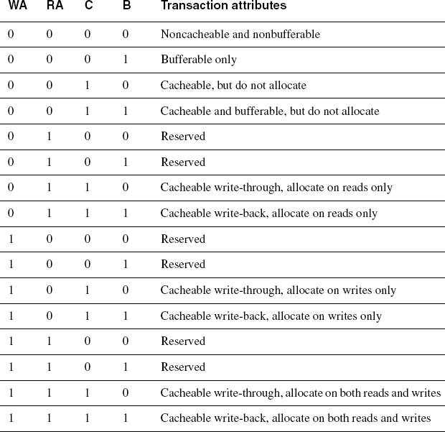
Cache Encoding

Slide 63
Protection Unit Support
To support complex system design, for the interconnect and other devices in the system to provide protection against illegal transactions
Normal or privileged, ARPROT[0] andAWPROT[0]
Low High
Secure or non-secure, ARPROT[1] andAWPROT[1]
Low High
Data or instruction, ARPROT[2] andAWPROT[2]
Low High

Slide 64
Topics
Overview of AXI
AXI Architecture and Features
Channel Definitions and Signals
Handshaking Process
Basic AXI Transactions
Types of Access (Atomic Access)
Ordering Model (Transaction ID tags)
AXI4 & AXI4 Lite

Slide 65
Atomic Access

Slide 66
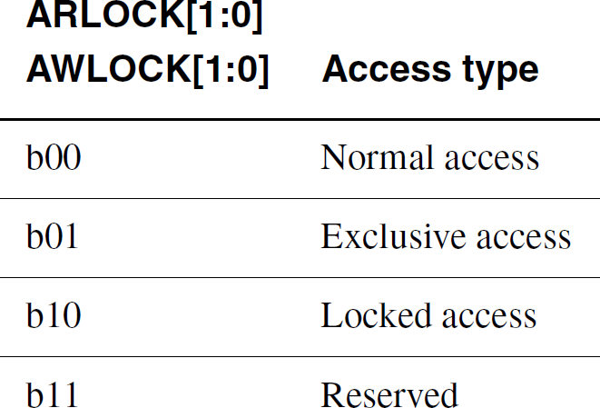
Atomic Accesses
Source: ARM AMBA AXI Protocol v1.0: Specification

Slide 67
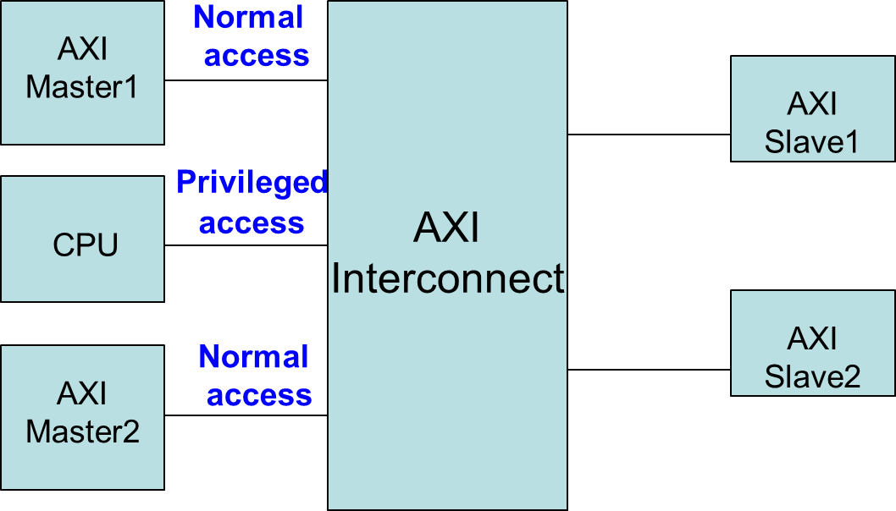
Normal / Privileged (`b00)
Used by some masters to indicate processing mode.
A privileged processing mode has a greater level of access within a system.

Slide 68
Exclusive Access (`b01)
Master1 Exclusive Read
Semaphore type without locking
the bus access
Exclusive Read success Response : EXOKAY
Exclusive Read fail Response : OKAY
Cycle 1
0 1 2 3 4 5
Master2 Write
Exclusive Write success Response : EXOKAY
Cycle 2
0 1 2 3 4 5
Master 1Exclusive Write
Exclusive Write fail
Response : OKAY
Cycle 3
0 1 2 3 4 5

Slide 69
Locked Access
Interconnect makes sure only one specific master is allowed access to the slave region until an unlocked transfer from the same master completes.
Purpose of use for longer and undisturbed transfers

Slide 70
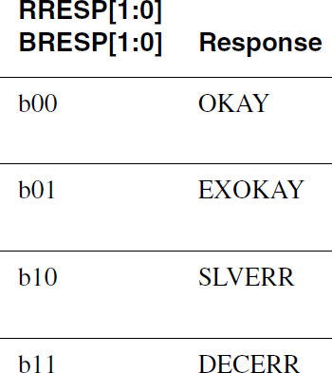
Response Signals
Accessed reached slave but
slave gives error to master
No slave present at transaction address interconnect responsible for decode error

Slide 71
Topics
Overview of AXI
AXI Architecture and Features
Channel Definitions and Signals
Handshaking Process
Basic AXI Transactions
Types of Access (Atomic Access)
Ordering Model (Transaction ID tags)
AXI4 & AXI4 Lite

Slide 72
Ordering Model

Slide 73
Ordering Model
AXI protocol enables out-of-order transaction completion and issuing of multiple outstanding addresses.
These features help maximize data throughput and system efficiency.
All transactions with same ID must be ordered, but there is no restriction on the ordering of transactions with different IDs.

Slide 74
Ordering Model ^{[1]}
Multiple Outstanding Address
Master is able to provide transaction addresses without waiting for earlier transactions to complete.
Write data Interleaving
If two masters generate write data sequence to the same slave, but write data doesn't arrive every clock cycle.
Instead of waiting for a data sequence to complete before other sequence starts, AXI system can interleave write data sequences avoiding idle cycles on the bus.
[1] AMBA AXI Protocol v 1.0 Specification, ARM, 2003.

Slide 75
Read Ordering
At master interface, read data from read transactions with same ARID value must arrive in same order in which master issued addresses.
Data from read transactions with different ARID values can return in any order and it is also acceptable to interleave the read data of transactions with different ARID fields.

Slide 76
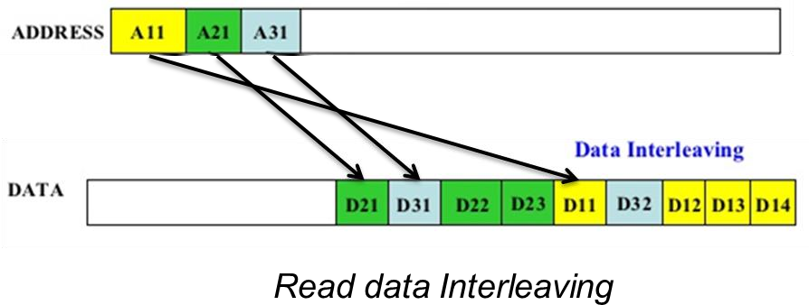
Read Data Interleaving^{[5]}

Slide 77
Normal Write Ordering
If a slave does not support write data interleaving the master must issue the data of write transactions in the same order in which it issues the transaction addresses.
Write data does not support out-of-order transactions but support data interleaving.

Slide 78
Write Data Interleaving^{[5]}
Write data interleaving enables a slave interface to accept interleaved write data with different AWID values.
Figure: Write data Interleaving

Slide 79
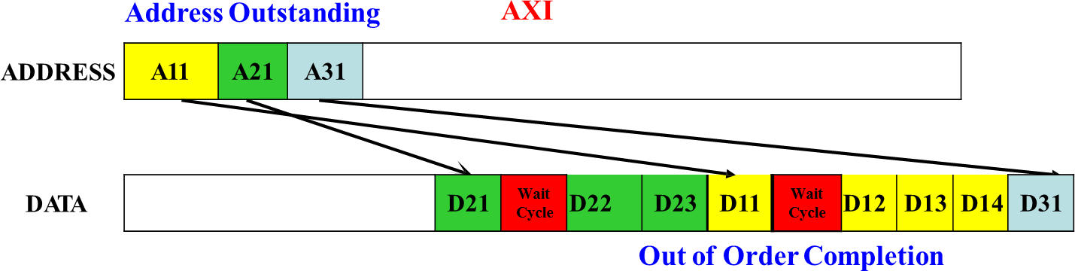
Out of Order Transaction
Transactions to faster memory regions can complete without waiting for previous transaction to slower memory regions.
Fast slaves may return data ahead of slow slaves

Slide 80
Aligned Transfer
Address: 0x00
Transfer size: 32 bits Burst type: incrementing Burst length: 4 transfers
For wrapping burst type, all transfers are aligned transfers
64-bit write data bus
63 56 55 48 47
40 39
32 31
24 23
16 15
8 7
0
7 | 6 | 5 | 4 | 3 | 2 | 1 | 0
WSTRB
0
0
0
0
0
1
1
0
7 | 6 | 5 | 4 | 3 | 2 | 1 | 0
7
6
5
4
3
2
1
0
WSTRB
0
1
0
1
0
0
0
0
F | E | D | C | B | A | 9 | 8
7
6
5
4
3
2
1
0
F | E | D | C | B | A | 9 | 8

Slide 81
Unaligned Transfer
Address: 0x07
Transfer size: 32 bits Burst type: incrementing Burst length: 4 transfers
For incrementing burst type, fist transfer can be unaligned transfers, but the rest transfers are aligned transfers
64-bit write data bus
63 56 55 48 47
40 39
32 31
24 23
16 15
8 7
0
7 | 6 | 5 | 4 | 3 | 2 | 1 | 0
WSTRB
1
0
0
0
0
0
0
0
F | E | D | C | B | A | 9 | 8
7
6
5
4
3
2
1
0
WSTRB
0
0
0
0
1
1
1
0
F | E | D | C | B | A | 9 | 8
7
6
5
4
3
2
1
0
17 | 16 | 15 | 14 | 13 | 12 | 11 | 10

Slide 82
Write Strobes
WSTRB Write strobes, signal indicates which byte lanes to update in memory.
One strobe for each eight bits of the write data bus.
WDATA : 8 – 1024 bits wide, WSTRB : 1 – 128 bits wide
64-bit write data bus
63 56 55 48 47
40 39
32 31
24 23
16 15
8 7
0
7 | 6 | 5 | 4 | 3 | 2 | 1 | 0
WSTRB
1
0
1
0
0
1
0
0

Slide 83
Topics
Overview of AXI
AXI Architecture and Features
Channel Definitions and Signals
Handshaking Process
Basic AXI Transactions
Types of Access (atomic accesses)
Ordering Model (AXI ID transaction)
AXI4 & AXI4 Lite

Slide 84
AXI4

Slide 85
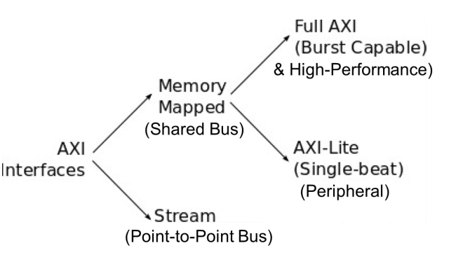
AXI Interfaces
Source: M.S. Sadri, Zynq Training

Slide 86
AXI4 Features
Support for cache coherency and enforced ordering.
Support for burst lengths up to 256 beats.
Support for Quality of Service signaling.
Support for multiple region interfaces.
AXI4 does not support locked transactions.

Slide 87
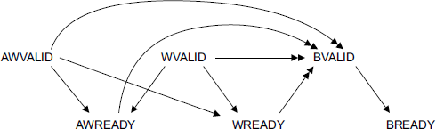
Write Response Dependencies
The AXI4 protocol requires that the write response for all transactions must not be given until the clock cycle after address acceptance
Write Response Dependencies

Slide 88
AXI4-Lite

Slide 89
AXI4-Lite
Key functionality of AXI4-Lite operation.
all transactions are of burst length of 1
all data accesses use full width of the data bus
Supports a data bus width of 32-bit or 64-bit.
all accesses are Non-modifiable, Non-bufferable
Exclusive accesses are not supported.
EXOKAY response is not supported on the read
data and write response channels
Length, Burst, Size related signals are not supported.
Bus Width can be 32/64 bit and supports strobe.

Slide 90
AXI4-Lite
No support data interleaving, the burst length is
defined as 1.
Does not support AXI IDs. Meaning, all transactions must be in order, and all accesses use a single fixed ID value.
Supports multiple outstanding transactions, but a slave can restrict this by the appropriate use of the handshake signals.

Slide 91
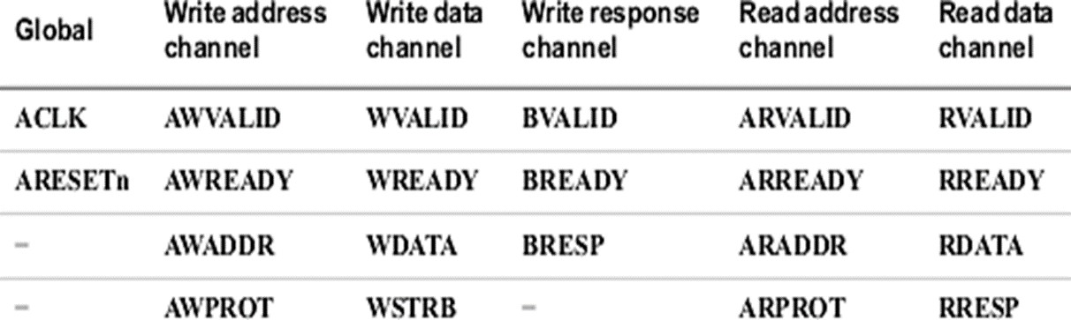
AXI4-Lite Signals

Slide 92
AXI4-Lite applications
Simple, low-performance peripherals
General Purpose Input Output (GPIO).
It’s a port used to connect any peripheral based on requirement where same port is used as input and output.
Universal Asynchronous Receiver Transmitter (UART Lite)

Slide 93
References
[1]
[2]
[3]
[4]
[5]
AMBA AXI Protocol v 1.0 Specification, ARM, 2003. AMBA Specification, Rev 2.0, ARM, 1999.
AMBA 4 AXI4-Stream Protocol Version 1.0 http://infocenter.arm.com/help/topic/com.arm.doc.set.amba https://www.slideshare.net/AzadMishra1/axi-protocol-55779579

Slide 94
Thank you

